Slide 1
Macarthur Girls High School
STEM ROBOTICS

Slide 2
Who we are?
Girls school in Parramatta years 7 to 12
1035 students
72 teaching staff
91.6% LBOTE (EALD)
History of integrated curriculum
Almost all senior students study at least 1 STEM related subject in HSC

Slide 3
STEM Team
Presenter Mr. Chris Johnson (science)
Presenter Mr. Stuart McGuire (TAS)
Ms. Cherry Smyth (science)
Ms. Melissa Thorpe (mathematics)
Mr. Daniel French (executive)

Slide 4
Project Outline
What? Design and build a robot prototypes to help people
Who? Year 7 students. Groups of 3-4 students
How? Using a series of set lessons to develop skills in robotics to allow them to build their own robot. With supporting STEM related activities to enhance their learning potential.

Slide 5
Robotic Challenge
"You and your team have just been employed by a new design and innovation company. You have been asked to identify an aged care or disability issue and then design and build a robot which will help to improve their quality of life. This robot is a prototype and not to scale. As designers you must ensure the robot functions correctly, is visually appealing and is safe."
Project launch

Slide 6
Project Components
Complete a series of introductory robotics challenges with supporting math challenges and science activities
A video log which documents the obstacles and solutions during the design process and building of their robot.
Research task on disabilities
A group design folio must including:
Design Brief
Research:
Inspirational research
technical research

Slide 7
Project Components
Generating creative ideas (brainstorming):
Individual students create profiles for different robot ideas
Planning sketching robot ideas potential ideas
The group analyses by using a check list (Criteria for success) .
Communicating ideas:
video logo/presentation,
pseudocode,

Slide 8
Project Components
Experimenting and testing ideas
Producing design solutions
Production modification of robot for design brief
Evaluating ideas and solutions
peer evaluating
video journal
A completed and functional robotic product which fulfils the design brief and purpose for which it was intended.

Slide 9
Project Outline: core lessons

Slide 10
Skills, knowledge and understanding
Problem solving
Critical thinking
Collaborative learning
Coding structures
Construction skills
Communication skills
Research skills

Slide 11
Skills, knowledge and understanding
Numeracy
Applying processes
Encouraging initiative and independent learning
Encouraging risk taking
Evaluation skills
Social responsibility and understanding

Slide 12
Timetable structure
Allocated STEM subject separate from science, mathematics and TAS
One semester of an integration subject and the other semester is for their STEM subject
Four72 minute periods per cycle
3 STEM teachers

Slide 13
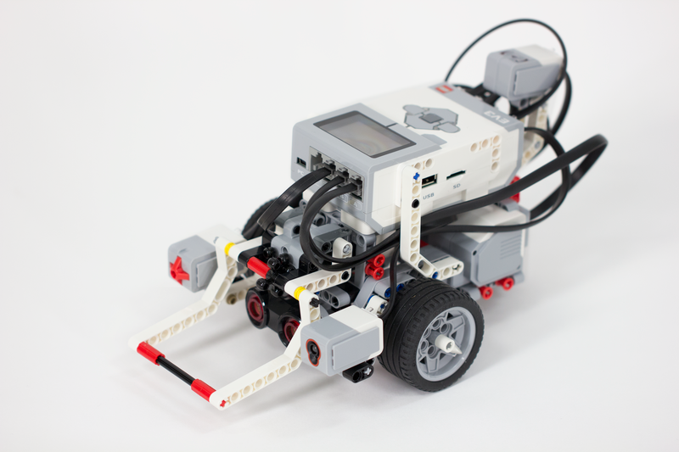
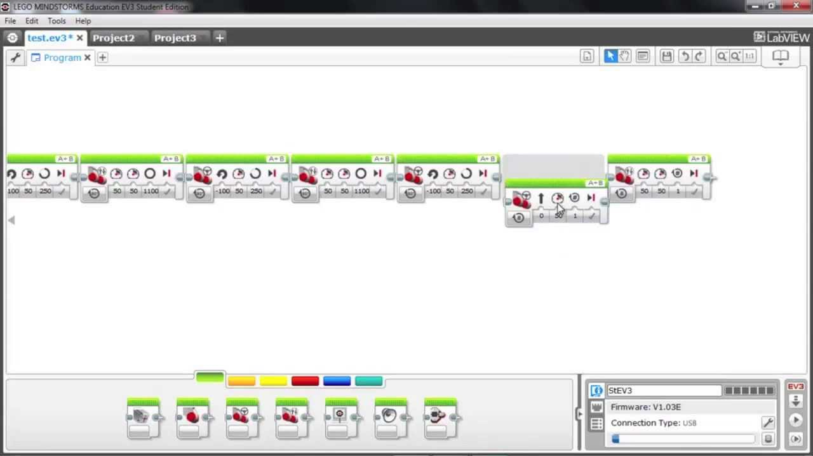
Resources
30 EV3 Robots and the Mind Storm software. Mind Storm Education (Building instructions and coding support)

Slide 14
Resources
BYOD Students bring their own devices.
Laptops, tablets and phones. Google docs and sheets

Slide 15
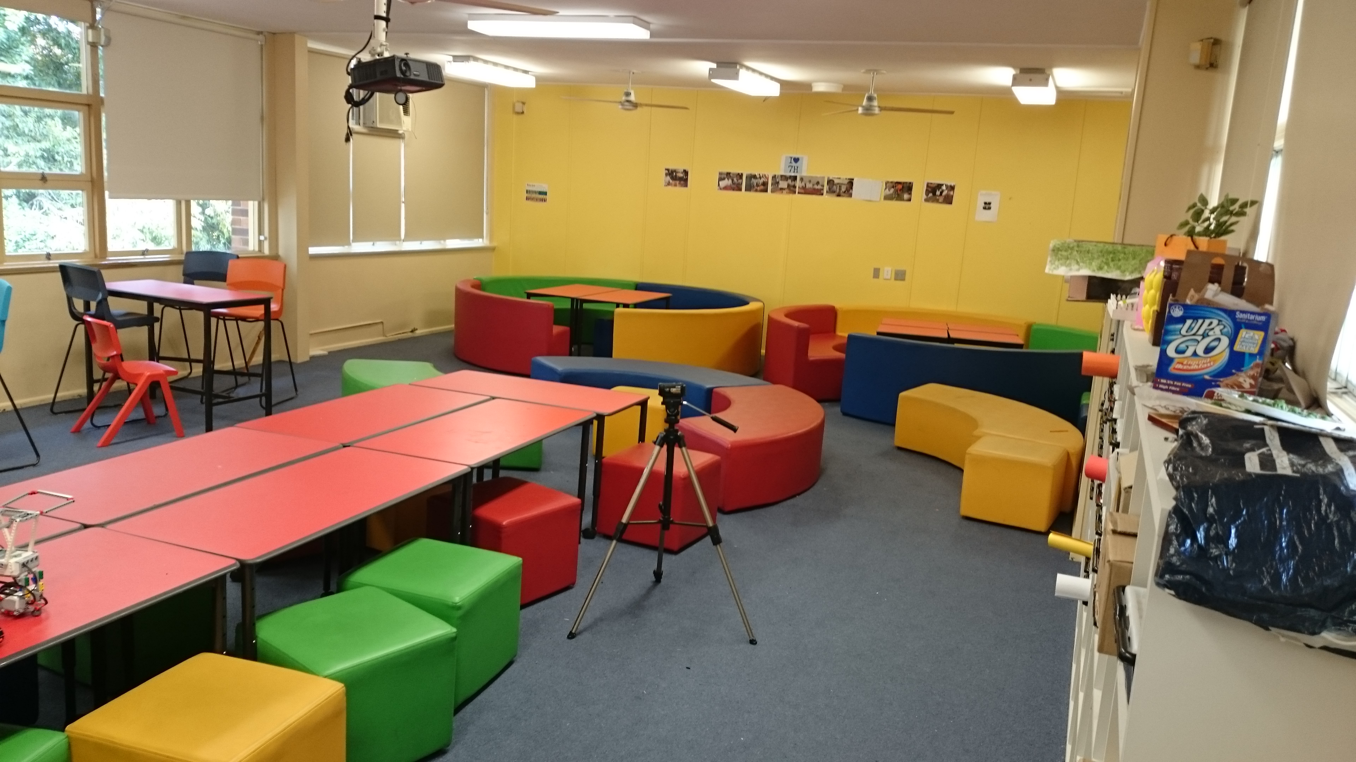
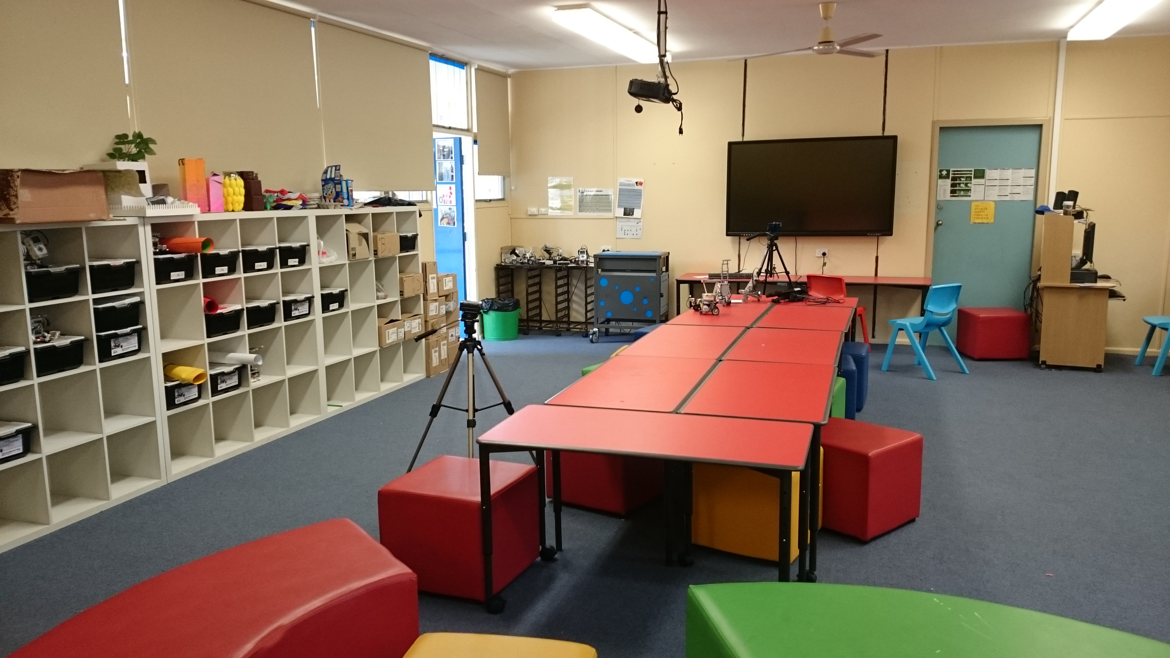
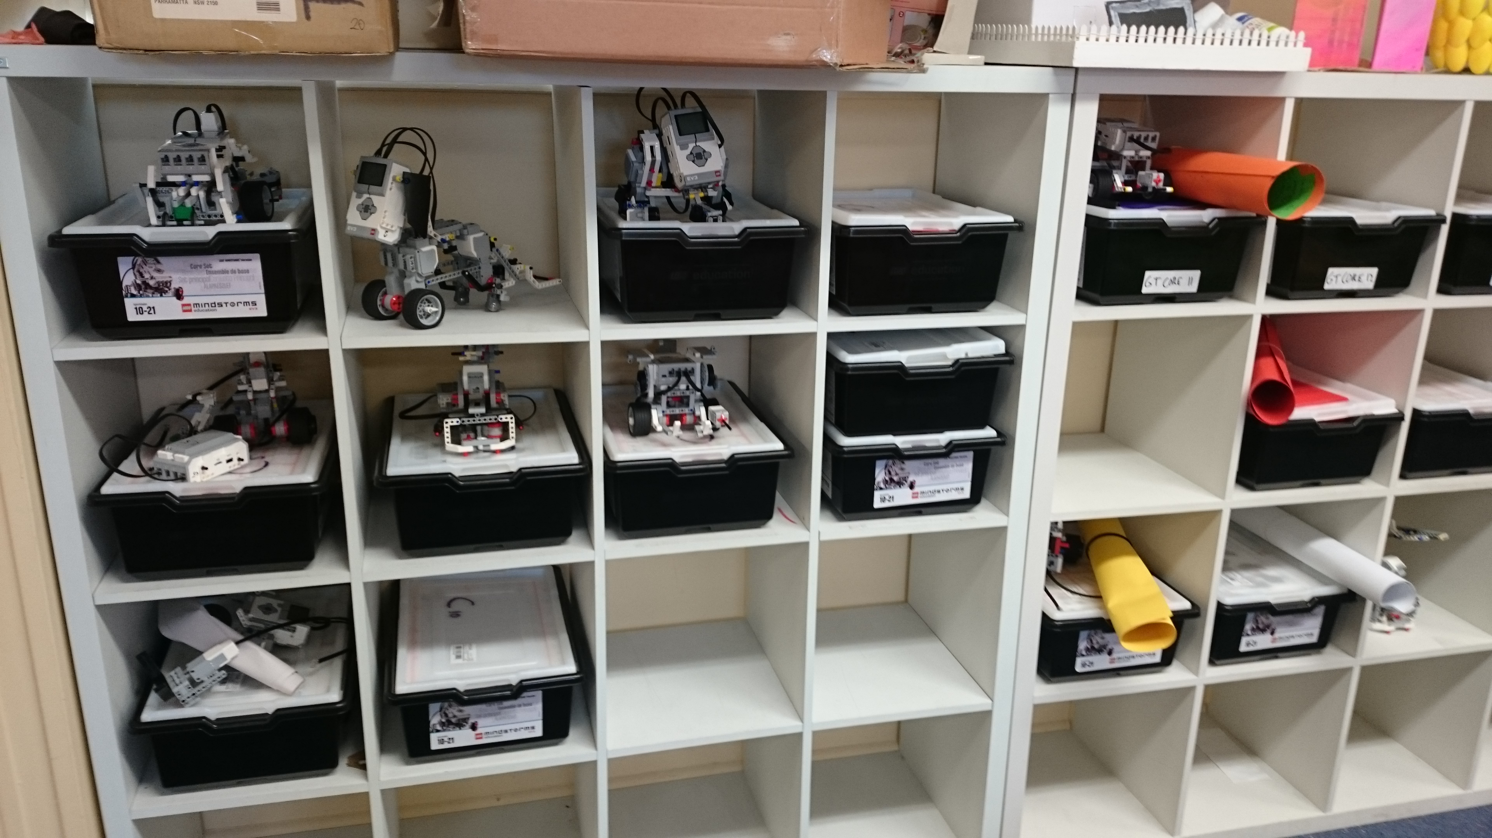
Resources
Classroom. Learning environment.

Slide 16
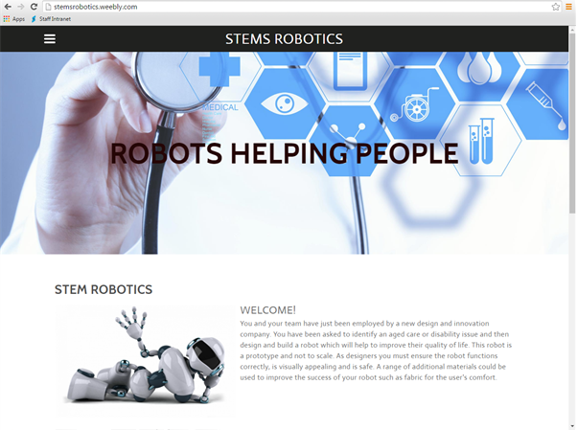
Resources
Our Weebly website (lesson and website structure based on modules)

Slide 17
Mathematics Components
When the students are required to become familiar with how the robot functions. They are to complete a number of tasks that enable them to understand the robots movement and how to program it using the Mind Storm software.
The Mathematics tasks were developed with this in mind. While the students are learning about the movement of the robot, they are also learning basic Mathematics concerning these movements.

Slide 18
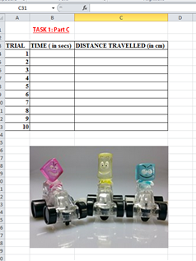
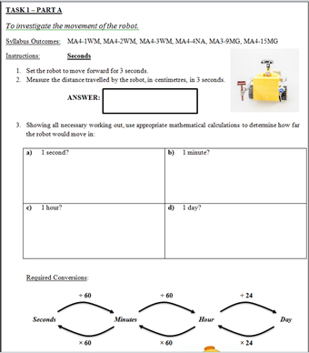
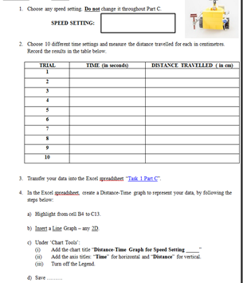
Mathematics activities using robots
Topics:
Time and distance conversions from the Measurement topic,
Graphing techniques from the Data analysis topic.

Slide 19
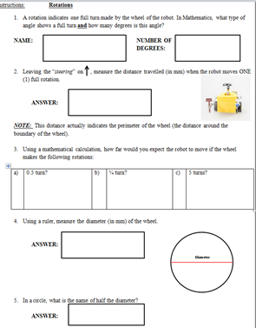
Mathematics activities using robots
Topics:
looking at types of angles from the Geometry topic,
perimeter / circumference of a circle from
the Measurement topic.

Slide 20
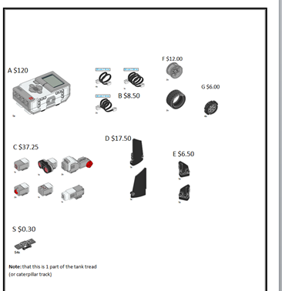
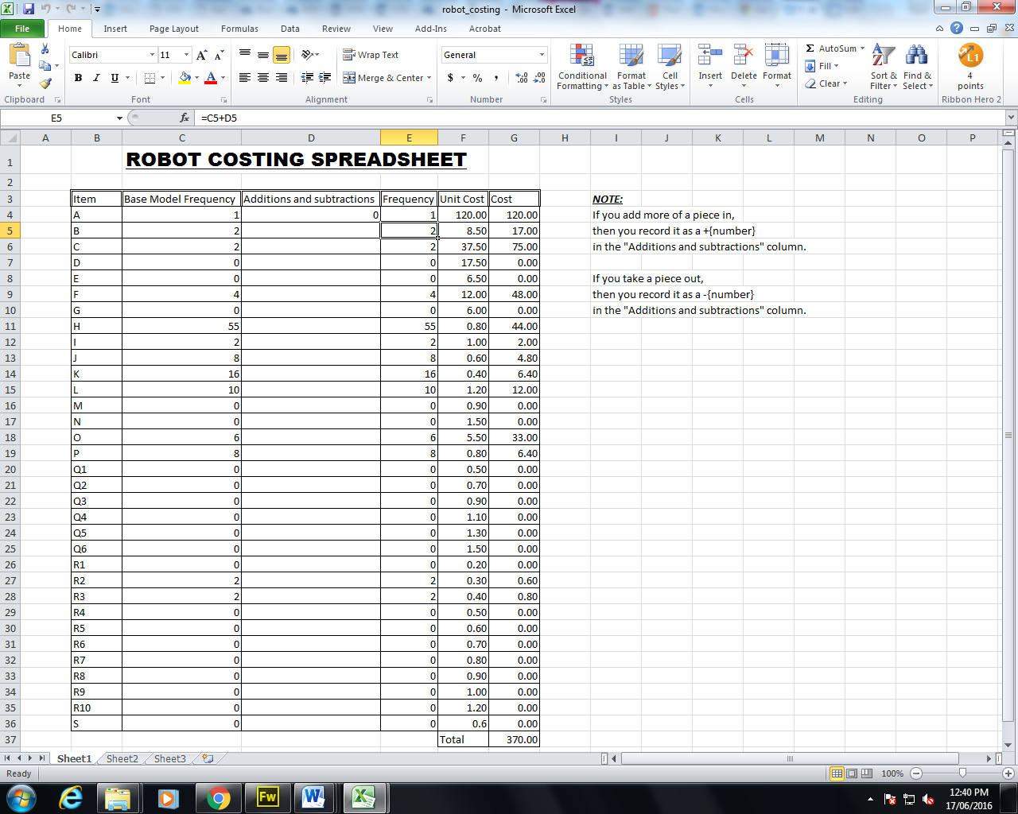
Mathematics activities using robots
Topics:
Students look at the cost analysis of building their robot.From the Number topic, students are using their arithmetic skills using money, as well as positive and negative numbers as they enter their data into the spreadsheet.

Slide 21
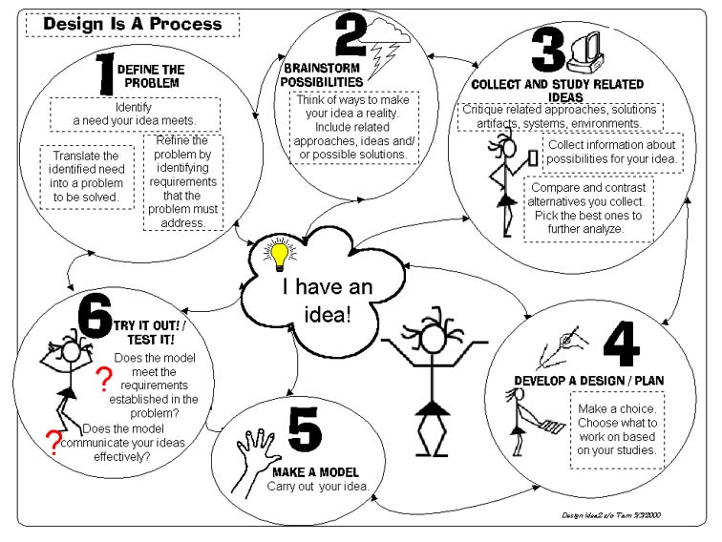
TAS Components
Design brief (problem solving), design process and folio components

Slide 22
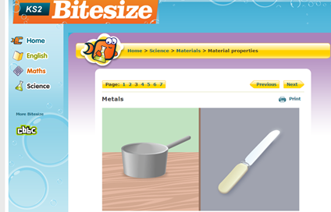
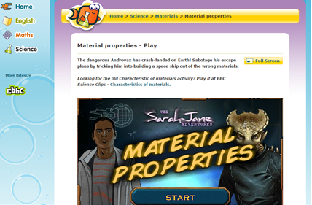
TAS Components
Technical and inspirational research linked to:
Material properties (bitesize and http://www.technologystudent.com/)

Slide 23
TAS Components
Technical and inspirational research linked to:
Energy
Robotic movements

Slide 24
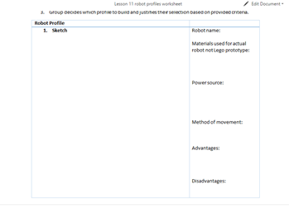
TAS Components
Idea development
(generating solutions)

Slide 25
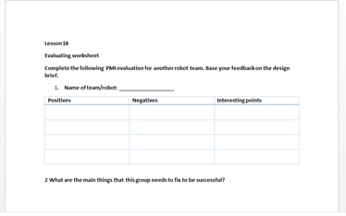
TAS Components
Production
Initial evaluation
(allowing the students
to improve based on
feedback)

Slide 26
Science Components
Knowledge and understanding components from the Stage 4 Physical world Syllabus outcomes primarily covering:-
simple forces and motion (PW1)
their application to solving problems in the world (PW1,4)
simple energy transfer concepts (PW3)

Slide 27
Science Components
Skills outcomes from Stage 4 Working scientifically syllabus outcomes including:-
research planning and conducting skills (WS5)
planning tests for and procedures to build their robots (WS5)
building and testing their robots (WS6)
Collecting data to integrate with the mathematics component of the course (WS6)
Using test data to program and modify their programs (WS7)
Proposing solutions to an identified problem, trial and modification through a design process to produce a solution (WS8)
Presentation skills for presenting their products at our STEM Robotics Fair (WS9)

Slide 28
Science Components

Slide 29
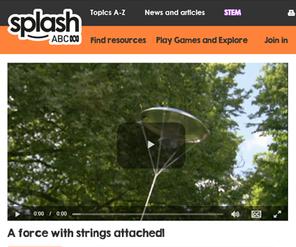
Science Components

Slide 30
Weebly website
http://stemsrobotics.weebly.com/

Slide 31
Teacher's attitudes and experiences
Robotic Expo held at school next week with student, parent, teacher and industry involvement.
Perhaps too ambitious with what was planned and had high expectations with student's previous experiences in STEM related areas.
Need to implement lessons on simple problem solving skills.
Students gaps in development stages and abilities:
From following set examples and instructions
To modification of set examples to suit their problems
To develop new solutions
Like to include mathematics and science based lessons for testing completed robots for example using weights to test structural integrity.
Additional time for student development

Slide 32
Student feedback

Slide 33
Questions?

