Slide 1
Shooting a Video with a Smartphone!
How to do a good job and make a great video!

Slide 2
http://wistia.com/library/shooting-video-with-an-iphone

Slide 3
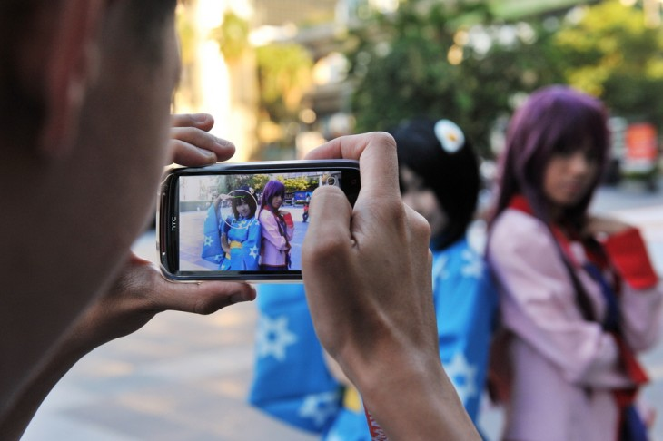
Shooting good video!
You can shoot high quality video that's ready to edit and upload to your website or assignment using your Smart phone’s camera, but if you just pull it out of your pocket and click record, chances are the end result will not look up to snuff.
Here are some quick tips for getting the most out of your Smart phone’s camera. While some of these suggestions are iPhone-specific, many can be applied to other smartphones, too!

Slide 4
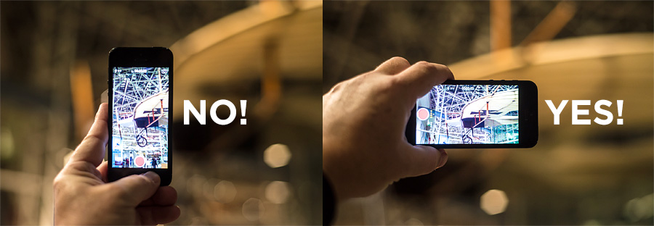
1. Don’t shoot vertical video!
We're living in a widescreen world! Laptops, televisions, your Twitter feed, and your website are all examples of places where a vertical video probably won't look great. So make sure you shoot horizontally!

Slide 5
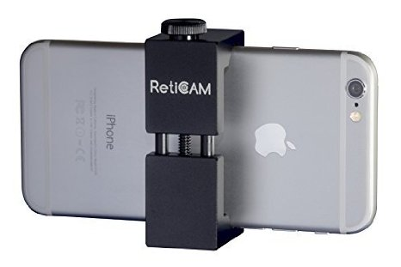
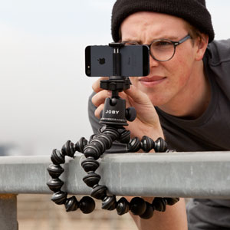
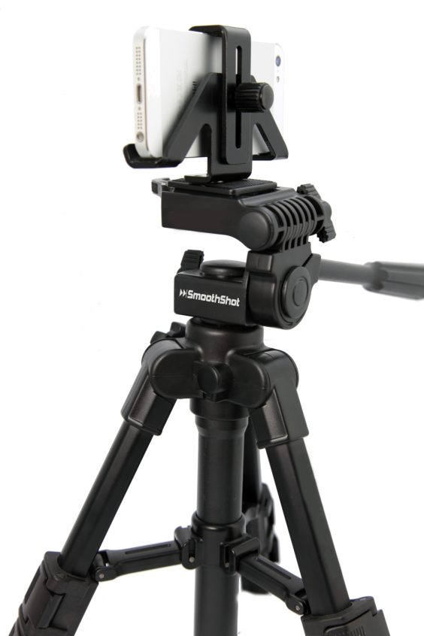
2. Use a tripod
No matter how steady your hands are, your Smart phone is going to have to work pretty hard to stabilize a handheld shot. If you're editing multiple takes, slight movements can be really distracting, so it's definitely worth the extra effort to stabilize your shots with a tripod.

Slide 6
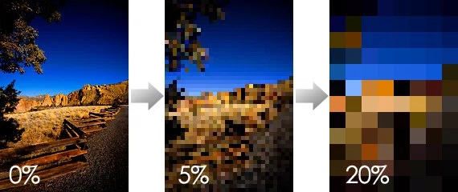
3. Don't use the Smart phone's zoom!
Avoid the temptation to use your smart phone's built-in camera zoom. Since the lens isn't zooming optically, you're just enlarging the picture digitally, which means you will quickly enter the world of unsightly pixels.
If you want to get a closer shot of your subject, just move your feet closer until you find the perfect shot!

Slide 7
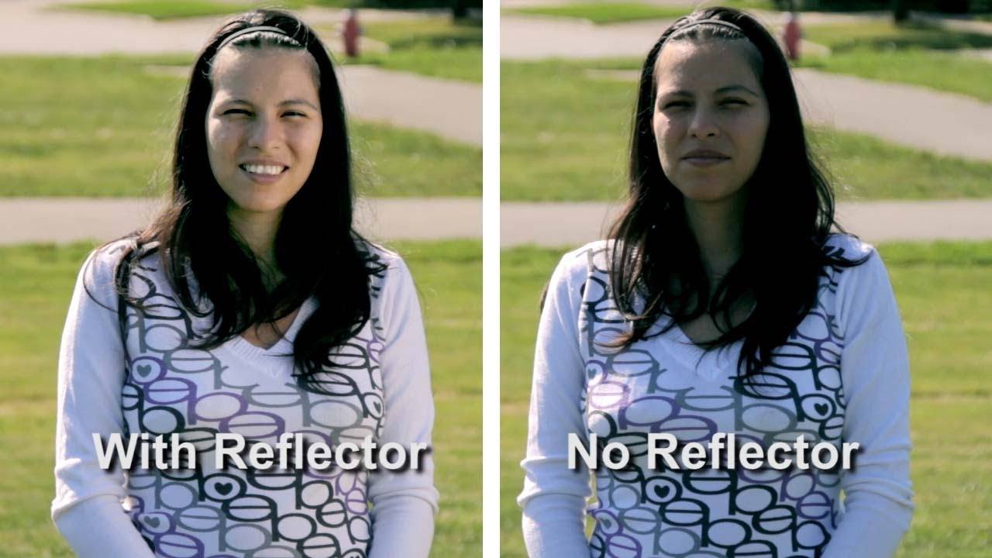
4. Light your video
The built-in camera flash on a Smart phone will never compare to using off-camera lights. If you have access to good lights use them. If not then use natural light smartly.
Always shoot with the subjects facing a window not with the window behind them. Same with the sun, face the direction the sun is coming from rather than away.
Use reflectors to reflect natural light onto the face of the subject, a big sheet of white paper or cardboard is enough to do this! Get creative. The more light on your subject the better the video will look!

Slide 8
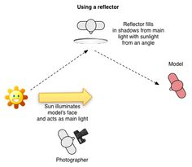
Poor lighting in front of a window

Slide 9
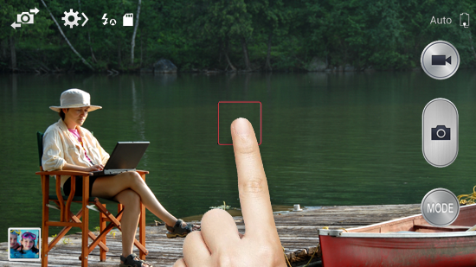
5. Use the exposure lock
The Smart phone will automatically focus and expose your shot. This can be a great function for quick photos, but when you're shooting a video of one person talking to the camera, it can really complicate things. The phone tends to keep adjusting and refocusing, which can lead to jittery-looking footage.
That's why it is recommended to use the exposure focus lock. This will help to keep the focus and exposure constant throughout your shot.

Slide 10
6. Get your microphone close to your subject
A general rule for clear audio is to get your microphone as close to your subject as possible.
When shooting video with an iPhone, it's best to position a second iPhone directly above the subject's head to record the audio. Creating a simple voice memo should do the trick!
Another option is to use an external microphone. You can plug a powered mic, like the Sennheiser ME66, into a KV microphone adapter, and it'll send the audio from the microphone directly into your iPhone.
Pro Tip: Clap once at the beginning of each take to create a reference point for syncing the good sound from the voice memo with the bad sound from the video recording.

Slide 11
7. Use a clip-on lens adapter for wider shots
Sometimes, you just need a wider shot, and the iPhone's fixed lens will limit how wide your shots can be. Being able to capture a wider shot is especially handy when you're shooting indoors or in small spaces.
A great workaround is to get a clip-on lens adapter. I'd only recommend using something like the Olloclip when you need to get a wider shot, but in those moments, it sure is handy!

Slide 12
8. Use slow motion wisely
You can get some amazing shots with the iPhone's built-in slowmo, but make sure the choice is motivated and fits your story. A shot of someone skiing will probably be great in slowmo. A shot of someone typing on their computer, on the other hand, might not be so interesting.

Slide 13
9. The Rule of Thirds
The rule of thirds is a concept in video and film production in which the frame is divided into into nine imaginary sections, as illustrated on the right. This creates reference points which act as guides for framing the image.
Points (or lines) of interest should occur at 1/3 or 2/3 of the way up (or across) the frame, rather than in the centre. Like many rules of framing, this is not always necessary (or desirable) but it is one of those rules you should understand well before you break it.
In most "people shots", the main line of interest is the line going through the eyes. In this shot, the eyes are placed approximately 1/3 of the way down the frame.
Depending on the type of shot, it's not always possible to place the eyes like this.
In this shot, the building takes up approximately 1/3 of the frame and the sky takes up the rest. This could be a weather shot, in which the subject is actually the sky.
Watch this video for a short explanation:- https://vimeo.com/1461280

Slide 14
10. Edit on your computer
There are some pretty cool editing apps available for the iPhone, but they still don't beat editing on your computer. When you finish shooting, plug your phone in, offload your footage, and import your videos into your editor of choice.
If you've never edited a video before, there's never been a better time to start! The iPhone's camera combined with some minor editing can unlock some serious potential. Free tools like iMovie have made editing easier for everyone.

Slide 15
References
Information was sourced from several locations including:-
http://wistia.com/library/shooting-video-with-an-iphone
https://www.youtube.com/watch?v=7GcpP-n-94I
https://www.google.com.au/search?q=rule+of+thirds+video&safe=strict&espv=2&biw=1302&bih=928&source=lnms&tbm=isch&sa=X&ved=0ahUKEwjQq86CwpnNAhUJnJQKHYmTAB8Q_AUIBygC&dpr=2#imgrc=8fHa10rH-NOYMM%3A

