Slide 1
HOW DO HUMAN SENSORS WORK? - understanding human sensors and comparing them with those in a robot

Slide 2
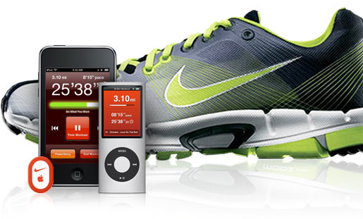
What is a Sensor?
Device that measures a physical quantity such as temperature and sends the information to a device such as a computer
Two types
Some detect presence of a stimulus (Type I). Can you think of an example?
Some detect quantity/value of a stimulus (Type II). Example?
What are the sensors that exist on the robot?
What are some examples of sensors in real life?
Some shoes now have sensors that can transmit the distance traveled to ipods!
Image1: For Source/Rights Refer to slide 27

Slide 3
What is a Sensor?
A sensor is a device that measures a physical quantity (stimulus) and transmits this measurement so that a computer, instrument, or observer can read it.
Some sensors simply detect the presence of a stimulus. These are called Type I sensors.
Other sensors can actually discern relative values of a stimulus. These are called Type II sensors.
Sensors are used in everyday objects such as garage doors that won’t shut if a kid/person is in its way – do you know how that works? Other applications that use sensors include cars, airplanes, robots, and medical equipment.

Slide 4
Human Sensors
Your sensory organs (eyes, ears, nose and skin) provide information to your brain so that it can make decisions. They work in a manner very similar to the working of sensors of an robot. Your brain uses the information that it receives from your sensory organs continuously and make your body work.
There are five senses in humans:
Your eyes allow you to see the world
Your skin lets you feel objects through touch
Your nose lets you smell the many scents present in the world
Your tongue lets you taste
…and several other sensors in the body that you don’t notice directly
Sensors in the inner ear give the brain information about balance
Sensors in our muscles that let the brain know our body position
Sensors throughout your body that sense temperature

Slide 5
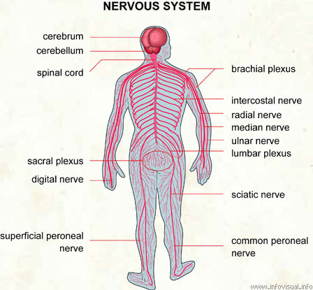
Human Sensors – signal transmission
When the sensors of the human body detect a stimulus, they send this information through the nervous system (like wires) to the brain. It has two main parts,
One is called the peripheral nervous system, which is a series of branches of single nerves. These are nerves that connect to every sensor in your body. They send signals to other nerves, which send signals to more nerves until the signal reaches the second part of the nervous system: the central nervous system.
The central nervous system consists of your spinal cord and your brain. The spinal cord is made up of bundles of nerves that are surrounded by bones for protection. Once a signal from a sensor reaches the spinal cord, it is sent up the cord to the brain. The brain decides what to do based on the information received.
Image2: For Source/Rights Refer to slide 27

Slide 6
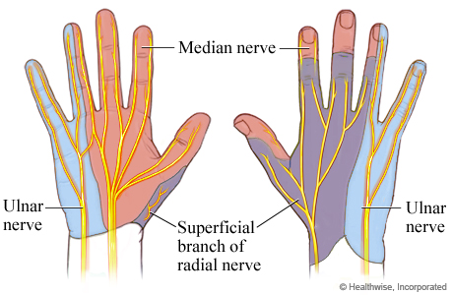
Touch: How do we Feel Using our Skin?
Skin contains millions of sensitive nerve endings that can detect stimuli such as
Pain
Pressure
Temperature
Many other stimuli we detect are other versions of the three above
Itching is small pain stimuli
Tickling is small pressure stimuli
When these receptors are stimulated, they send signals through your nervous system to the brain which recognizes that something has been touched.
Image3: For Source/Rights Refer to slide 27

Slide 7
Touch Sensors Activity
Activity:
Each person pick a partner
Each group of two should have two pencils
One partner close his/her eyes and extends his/her hand to the other partner
Second partner pokes the first partner’s hand with either one or two pencils, and have them guess whether one or two pencils were used. Try different distances apart when using two pencils at a time.
Attempt this at various locations on the hand, starting at the palm and ending at the back of the forearm and discuss results.
Switch roles. Discuss findings as a group.
Notes:
The touch sensor activity is approx. 7 min. Teacher to lead discussion of all student findings (Discussion: 5 min)

Slide 8
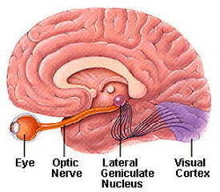
Vision: How does the brain know what we look at?
Light (stimulus) enters the eye
It passes through the optic nerve
Lateral Geniculate Nucleus (LGN) relays the information to the visual cortex
Visual Cortex processes this information

Slide 9
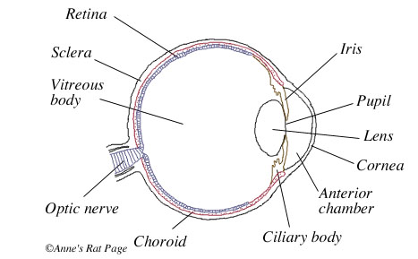
How do Your Eyes Work?
First, light enters your eye, and is refracted, or bent, by the cornea, the outermost part of your eye.
Refracted light is directed right at the pupil, a small hole in the center of the iris, the colored part of the eye. The iris can change the size of the pupil to allow more or less light to enter.
Light that goes through the pupil is then redirected again by the eye’s lens, which points the light at nerve cells in the back of your eye.
There are two types of nerve cells in the back:
Cones detect colors and fine details in good light.
They are concentrated in the center of the
back part of your eye.
Rods detect the presence of objects in bad light
and are concentrated on the sides of the back part of your eye.
Cones and rod send signal through the optic nerve to brain.

Slide 10
Various parts of the human eye
Image 4: For Source/Rights Refer to slide 27

Slide 11
Various parts of the human ear
Image 5: For Source/Rights Refer to slide 27

Slide 12
How do we hear
Sound funnels into the ear canal and causes the eardrum to move.
The eardrum vibrates with sound.
Sound vibrations move through the ossicles to the cochlea.
Sound vibrations cause the fluid in the cochlea to move.
Fluid movement causes the hair cells to bend. Hair cells create neural signals which are picked up by the auditory nerve. Hair cells at one end of the cochlea send low pitch sound information and hair cells at the other end send high pitch sound information.
The auditory nerve sends signals to the brain where they are interpreted as sounds.
Balance and the ear
The semicircular canals also contain fluid and hair cells, but these hair cells are responsible for detecting movement rather than sound. When you move your head, the fluid within the semicircular canals (which sit at right angles to each other) also moves. This fluid motion is detected by the hair cells, which then send nerve impulses about the position of your head and body to the brain to allow you to maintain your balance.

Slide 13
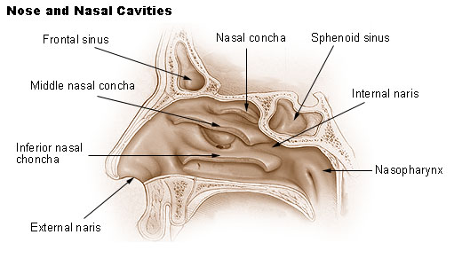
Smell: How do we Smell Using our Nose?
Small particles of almost everything around us can be found in the air.
These particles enter the nose when you breathe in and contact nerve endings in the upper nasal passage.
These nerve endings send a signal through the nervous system to the brain, which makes sense of the smell.
Humans can distinguish between hundreds of different smells. Dogs can distinguish between thousands.
http://videos.howstuffworks.com/howstuffworks/461-how-smell-works-video.htm
Image 6: For Source/Rights Refer to slide 27
Notes:
Teacher to show video to the class

Slide 14
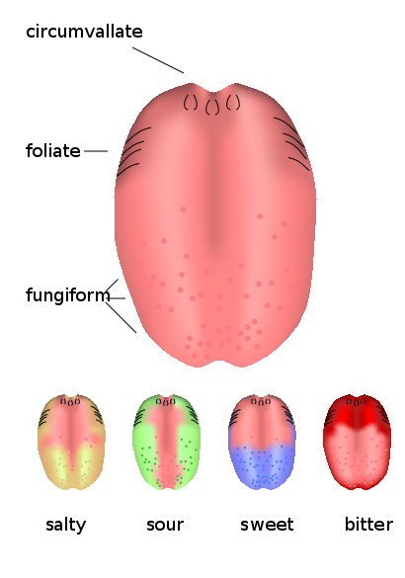
Taste: How do we Taste Using our Tongue?
The tongue has sensory receptors called taste buds that
can detect one of five different flavors
Sweet
Salty
Bitter
Sour
Umami
Umami is a flavor that is said to be present in many
high-protein foods, such as meats, cheeses, tomatoes
and mushrooms, and is generally described as being a
savory, meaty taste.
Taste buds are comprised of cells called gustatory
receptor cells. These cells have tiny hairs that detect
taste from the food that you eat. The hairs send information
to the cells, which send a signal through the nervous system
to the brain, which interprets the information as taste.
What is the difference between taste and flavor?
Flavor includes taste, but also a little more. It comprises taste, smell,
texture of food, and even other sensations such as pain when you eat
something spicy. Eating food with your nose blocked shows a marked
decrease in flavor, even though the taste is the same.
Image 7: For Source/Rights Refer to slide 27

Slide 15
Taste Activity
Activity requiring Starburst (or other) flavored candy:
Pair students in groups of two
Each student get two pieces of Starburst candy - the other student should not know the flavors that his/her partner has.
One partner should close his/her eyes and close his/her nose while the other partner unwraps and gives him/her one piece of candy. The taster should then guess the flavor of the candy.
Then, the taster should wipe their tongue dry with a paper towel, close their eyes, and be given the other piece of candy and guess its flavor.
Switch roles.
Discuss findings as a group after all the groups are done.
Notes:
The touch sensor activity is approx. 7 min. Teacher to lead discussion of all student findings (Discussion: 5 min)

Slide 16
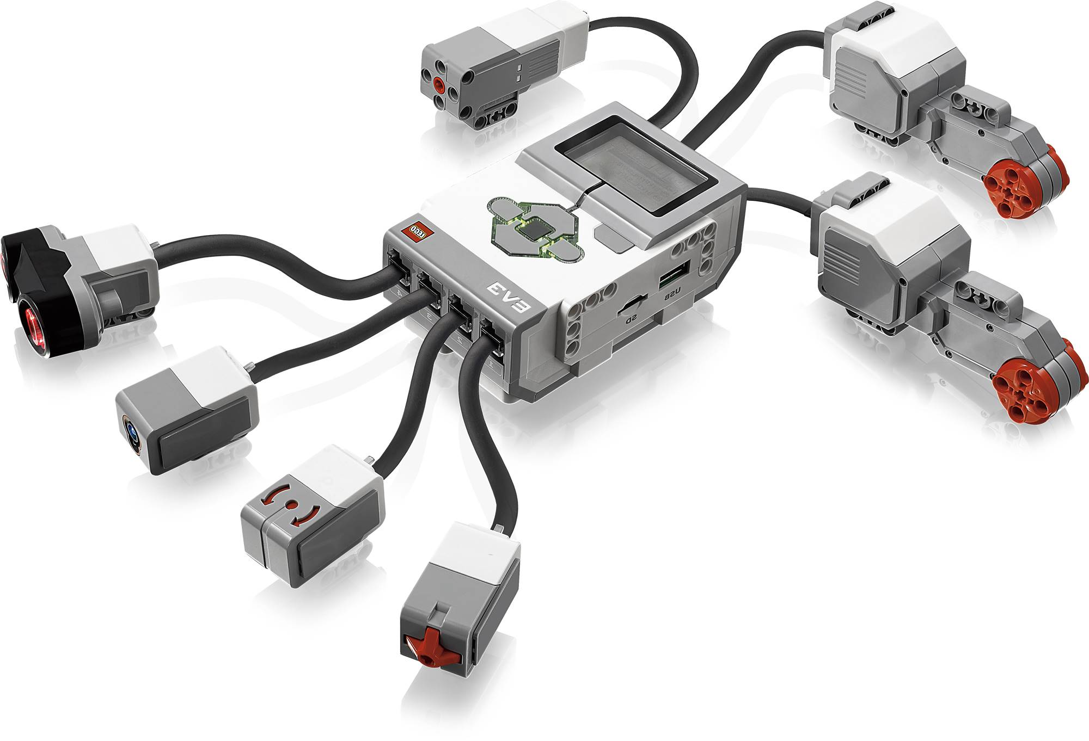
EV3 ROBOT Sensors
What do they do?
Gather information from the surroundings and send it to the computer brick.
Robot Sensors can only be used if the Robot’s program asks for information from them!
Similarly, the Robot can only act on information from the sensors if its program tells it to do so!
How do sensors send signals to the Computer brick?
The sensors send information through the wires (similar to the nervous system in your body) that connect them to the Computer brick, which uses the information if its program requires it.

Slide 17
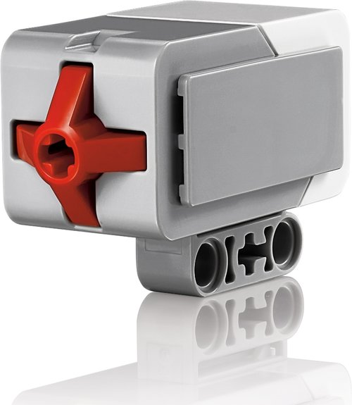
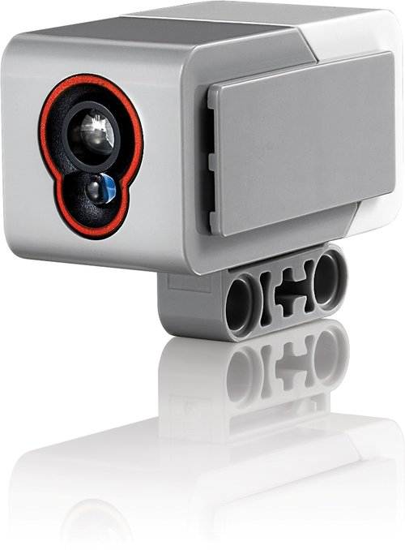
How do Robot Sensors Work?
Touch Sensor
Button-like protrusion. When bumped, it sends a signal to the computer brick saying that it has been touched
Color Sensor
Works in two different ways
Can detect the amount of ambient light and convert it to a numerical value. This value is sent to the Computer brick
Can send out light and detect how much is reflected by an object. This is to detect brightness of an object. Converts amount of reflected light to a numerical value and sends it to the Computer brick. If no object is in front of the sensor, it sends a value of zero.

Slide 18
How do Robot Sensors Work? (cont.)
Ultrasonic Sensor
The Ultrasonic Sensor has two parts
A transmitter that sends out a signal that humans cannot hear
A receiver that receives the signal after it has bounced off of nearby objects
The sensors sends out its signal and determines how long the signal takes to come back.
If the object is very close to the sensor, the signal will come back quickly
If the object is far away from the sensor, the signal takes longer to come back
If objects are too far away from the sensor, the signal will take so long to come back (or be so weak when it comes back) that the receiver cannot detect it
The Ultrasonic Sensor sends a message back to the computer brick, telling it the time taken for the signal to return. The computer brick then uses this information to compute how far away the object was.
Can you name a process performed by certain animals that works like this?

Slide 19
What are robot equivalents of human sensors?
Human sensor | Equivalent robot sensor
Eyes | Light sensor, Ultrasonic sensor
Skin | Touch sensor
Smell | None for Lego EV3
Taste | None for Lego EV3

Slide 20
PRE/POST- ASSESSMENT SHEET HOW DO HUMAN SENSORS WORK?
1. What sensors or senses do we humans have?
2. Describe how any two of the sensors you listed above work.
3. Give examples of sensors in robots that are similar to human senses.

Slide 21
PRE/POST- ASSESSMENT SHEET HOW DO HUMAN SENSORS WORK?
1. What sensors or senses do we humans have ?
Eyes, Ears, Nose, Skin, Tongue, (other sensors include temperature sensors, sensors detecting body position, balance sensors, blood acidity sensors, …)
2. Describe how any two of the sensors you listed above work.
Eye – takes in light from the surroundings and relays that to nerve cells that send images to the brain
Nose – particles are inhaled into the nose and nerve cells contact particles and send signals to the brain
Skin- sensors all over skin are activated and send signals to the brain through nervous system
Tongue- taste buds are made up of small cells that have little hairs that are activated by particles in food. These hairs send signals through nerves to the brain.
3. Give examples of sensors in robots that are similar to human senses.
Eyes – color sensor, ultrasonic sensor
Skin – touch sensor

Slide 22
Image Source/Rights
Image 1:ADA Description: Shoe with ipod embedded in it.
Image file name: shoe design
Source/Rights: http://www.gadgetsharp.com/20091123/9-creative-and-high-tech-shoes-designs/
Image 2:ADA Description: Human Nervous System.
Image file name: Nervous System
Source/Rights: http://www.infovisual.info/03/038_en.html
Image 3:ADA Description: Nerves in human hand.
Image file name: battery.jif
Source/Rights: static.howstuffworks.com/gif/battery.gif
Image 4:ADA Description: Human Eye.
Image file name: Human eye.jpg
Source/Rights: http://www.ratbehavior.org/Eyes.htm
Image 5:ADA Description: Human Ear anatomy.
Image file name: HumanEar.jpg
Source/Rights: www.commons.wikimedia.org

Slide 23
Image Source/Rights
Image 6:ADA Description: Human Nose Anatomy.
Image file name: Illu_nose_nasal_cavities.jpg
Source/Rights: commons.wikimedia.org
Image 7:ADA Description: Taste buds on human tongue.
Image file name: Kieli_kaikki_en.svg
Source/Rights: http//commons.wikimedia.org/wiki/

